Slide 1
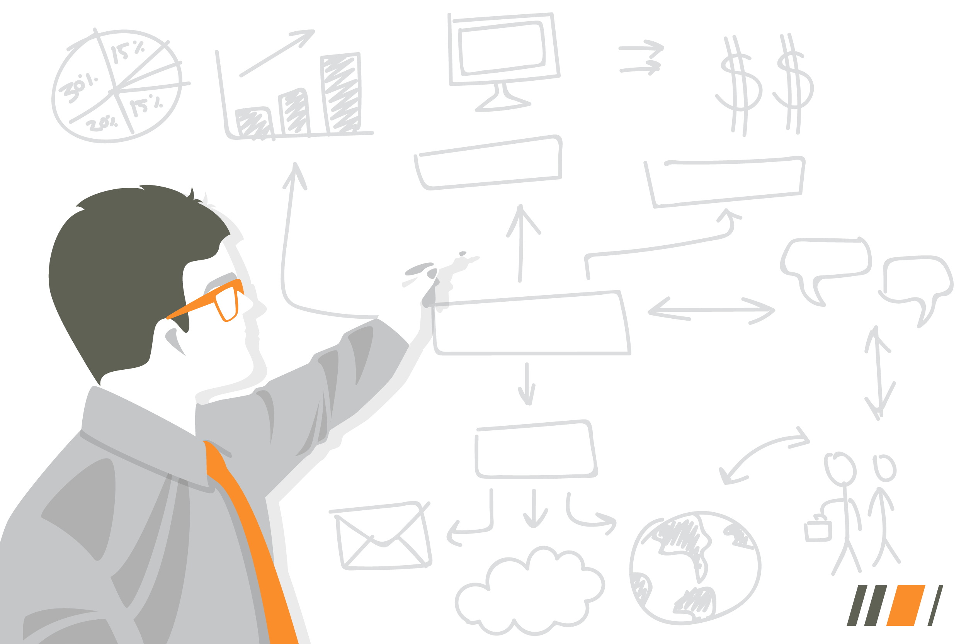
Building A Resilient Business
The Calgary Leader’s Guide to IT That Holds Up Under Pressure
Alex McGillivray
CEO, Sure Systems
alex.mcgillivray@suresystems.ca
403.539.9688
Notes:
Welcome everyone. Today we are talking about building resilient businesses. Not about fear or selling you something, but about what happens when things go sideways and how prepared your organization is for that moment.
Quick intro: who I am, what Sure Systems does, and why this topic is worth your time today.

Slide 2

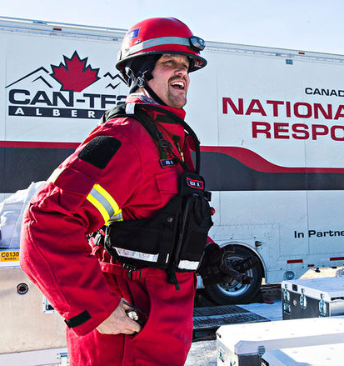
Why this topic matters to me
While working at Sure Systems, I had the opportunity to volunteer with Canada Task Force 2 (CAN‑TF2) — Alberta’s disaster response team.
I was invited to join based on my technical and business background. I was there to support the First Responders by helping set up and operate IT and communications systems that are critical during complex, high‑pressure scenarios.
Working alongside firefighters, medics, engineers, and search‑and‑rescue specialists, this taught me some practical lessons that still shape how I think about business resilience today:
  Serious problems rarely start out serious
  The first hour matters most.
  Clear roles, a defined team, beat a smart person every time
  Calm and rehearsed responses prevent small failures from becoming big ones
That mindset is what this session is about.
Not fear. Not perfection. Predictable behavior under pressure.
Notes:
This is the personal story. I volunteered with Canada Task Force 2, Alberta’s disaster response team. I was there for IT and communications support, working alongside first responders.
The lessons I took away are simple: serious problems rarely start out serious, the first hour matters most, clear roles beat a smart individual, and calm rehearsed responses keep small failures from becoming big ones.
That mindset is what this whole session is built around. Not perfection. Predictable behavior under pressure.

Slide 3
Why We Are Here: To increase the resilience of our Businesses
Most organizations focus on preventing problems.
Resilient organizations not only focus on preventing problems but also what happens when something breaks.
They prepare for the best and plan for the worst.
    Protection tries to stop bad things from happening.
    Resilience assumes something eventually will.
Resilient Businesses recover quicker than the unprepared and with better outcomes.
Notes:
Most organizations put all their energy into preventing problems. That matters. But resilient organizations also think about what happens when something breaks anyway.
Protection tries to stop bad things. Resilience assumes something eventually will happen. The difference is that resilient businesses recover faster and with better outcomes.

Slide 4
Not If…..When
Every organization asks: “Are we going to get hit?”
Resilient organizations ask a better question: “When something goes wrong, what does that day look like?”
Because outages, mistakes, and incidents are not hypothetical. They are operational reality.
Notes:
This is a mindset shift. Most organizations ask whether they will get hit. Resilient organizations ask a better question: when something goes wrong, what does that day actually look like?
Outages, mistakes, and incidents are not hypothetical. They are operational reality. The question is whether you have thought through what happens next.

Slide 5

Prevention Still Matters
But, let’s be clear. Prevention is still critical
Good security, good design, and good habits:
Reduce how often incidents occur
Catch problems earlier
Lower the overall risk
But no amount of prevention eliminates failure entirely.
The goal is to prevent what you can, and be ready for what you can’t
Notes:
Important to say this clearly: prevention is still critical. Good security, good design, and good habits reduce how often incidents happen, catch problems earlier, and lower risk overall.
But no amount of prevention eliminates failure entirely. The goal is to prevent what you can, and be ready for what you cannot.

Slide 6
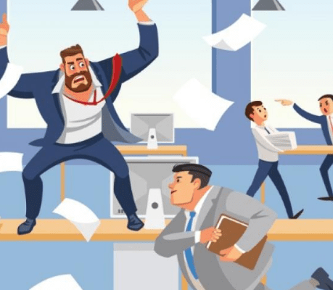
What an Incident looks like
NON-RESILIENT BUSINESS
When something goes wrong:
Confusion about what is happening
Delay while people debate next steps
Multiple people making decisions at once
Leadership reacting in real time
Recovery taking longer than expected
That chaos causes more damage than the incident itself.
Notes:
Paint the picture here. When something goes wrong in an unprepared organization, you get confusion, delays, multiple people making decisions at once, leadership reacting in real time, and recovery taking longer than it should.
The key point: that chaos causes more damage than the incident itself. Let that land with the audience.

Slide 7

What an Incident looks like
RESILIENT BUSINESS
When something goes wrong:
The blast radius is limited
The first steps are already known
Escalation happens early
Leadership creates calm
Recovery can be quick, boring and procedural
Incidents are disruptive, not existential.
Notes:
Now flip it. In a resilient organization, the blast radius is limited, the first steps are already known, escalation happens early, leadership creates calm, and recovery is quick and procedural.
The big line here: incidents are disruptive, not existential. That is the difference resilience makes.

Slide 8

The Four Pillars of Business Resilience
Resilience is not a product you buy.
It is a posture you build across four areas:
Shock Absorption
Coordinated Response
Human Reliability
Leadership Clarity Under Stress
Notes:
This is the framework for the rest of the presentation. Resilience is not a product you buy. It is a posture you build across four areas: shock absorption, coordinated response, human reliability, and leadership clarity under stress.
Briefly introduce each one here and let the audience know you will go deeper on each.

Slide 9
Pillar 1
Shock Absorption
How much of the blast reaches the business?
This pillar focuses on:
Limiting spread
Containing mistakes
Detecting trouble early
Good defenses don’t stop every incident. They stop small problems from becoming big ones.
Notes:
Scenario: “Compromised inbox, caught early, contained fast”
Setup (normal day, nothing dramatic):
An employee gets a convincing email that looks like a Microsoft sign in prompt. They enter credentials. No fireworks, no ransom note, just a quiet compromise. This is exactly how “serious problems rarely start out serious.”
Early signals we could detect (trouble early):
• A sign in attempt from an unusual location
• Multiple failed sign ins followed by a successful one
• A new inbox rule gets created that quietly forwards messages externally
• A sudden spike in SharePoint or OneDrive downloads
These are not “end of the world” alerts. They are early smoke.
What a resilient org does in Pillar 1 terms:
This is where Shock Absorption matters. We detect early and we keep the blast radius small.
Containment steps that limit spread (blast radius control):
• Immediately disable the session and force sign out
• Reset password and re register MFA if needed
• Remove the malicious inbox rule and check for OAuth app consent
• Verify no privileged accounts were touched
• Check whether the attacker tried lateral movement, for example into Teams, SharePoint, finance mailboxes
The point is not “perfect prevention.” The point is that small problems do not get to become big ones because we see them early and contain them by design. [
The “so what” for leaders:
Most organizations think the incident is the phishing email. The real incident is what happens next. If we detect early and contain fast, the story becomes boring and procedural, not chaotic. [
Quick “callouts”
• “Detection is the difference between an inconvenience and an incident.”
• “We don’t need to stop every mistake. We need to stop mistakes from spreading.”
• “Most damage comes from delay, confusion, and debate, not the original event.”

Slide 10
Pillar 2
Coordinated Response
Do people know what to do without questioning?
This pillar focuses on:
Clear first 30‑minute actions
Known decision owners
Tested recovery under pressure
Plans matter so people don’t freeze.
Notes:
Scenario: “Ransomware signals appear, response is immediate and organized”
Setup (normal day, nothing dramatic):
It’s a regular workday. A few users start reporting that shared files will not open, or filenames look strange. Almost at the same time, an alert shows unusual file activity on a server. At this moment, we do not know if it is a true ransomware event or something benign, but the early indicators are serious enough that we treat it as real until proven otherwise.
What a non resilient org does (why it gets messy fast):
• People debate whether it is “really ransomware”
• Multiple people start poking at systems at the same time
• No one is clearly in charge of decisions
• Leadership is forced to react in real time
That chaos causes more damage than the incident itself.
What a resilient org does instead (Pillar 2 in action):
This pillar is about whether people know what to do without questioning. Plans matter so people do not freeze.
The goal is that the first hour is calm, coordinated, and predictable, not a live debate. [
The first 30 minutes (this is the point of Pillar 2)
This is the part you can say out loud:
“We are not trying to be brilliant in the moment. We are trying to be boring on purpose.”
Minute 0 to 5: Declare and stabilize
• Name it: “Potential ransomware event. We are activating incident response.”
• Assign roles immediately (even if it is a small team):
• One person is the decision owner
• One person is the technical lead
• One person owns communications
This is the idea behind an Incident Response Plan and an ICS style structure.
Minute 5 to 15: Contain first, investigate second
• Stop the spread before trying to diagnose root cause
• Isolate affected machines or network segments
• Disable risky access paths if needed
• Preserve evidence rather than wiping things blindly
This is the discipline that keeps the incident from expanding while everyone is still gathering facts. [
Minute 15 to 30: Start the coordination loop
• Establish a single “source of truth” channel for updates
• Confirm what business functions are most critical to restore first
• Begin a communication rhythm: short, factual updates, no speculation
• Decide what gets taken offline and who can authorize that decision
The big win is avoiding duplicated effort, confusion, and conflicting direction.
What “known decision owners” actually means (plain language)
During an incident, you want no committees in the moment.
• One role decides priorities and risk calls
• One role executes the technical plan
• One role communicates status and next update time
Clear ownership prevents the first hour from being spent debating instead of executing.
Where tabletop exercises fit (why this becomes real)
A tabletop is a calm walkthrough that clarifies:
• Who is actually in charge when something breaks
• Whether escalation happens early or late
• How the first hour decisions would play out
It is improvement, not evaluation.
Quick callouts you can use while presenting
• “Speed and clarity matter more than perfect information.”
• “The first hour is where organizations either get organized, or get hurt.”
• “Calm responses prevent small failures from becoming big ones.”
• “Resilient recovery is quick, boring, and procedural.”

Slide 11
Pillar 3
Human Reliability
Do people behave predictably when something feels wrong?
This pillar focuses on:
Early escalation
Clear who‑to‑call rules
Supporting assigned high‑risk roles
Technology fails quietly. People fail loudly. Resilience makes those failures containable.
Notes:
Scenario: “It feels weird. Someone escalates early instead of waiting.”
Setup (normal day, nothing dramatic):
A staff member gets an email that looks routine, but something feels off. The tone is slightly unusual, the request is urgent, and it involves money or sensitive information. They are not sure it’s malicious, but it does not feel normal. This is where human reliability matters because technology often fails quietly, and the human moment is what determines whether it stays small or spreads.
What a non resilient org looks like in this moment:
Someone hesitates because they do not want to look silly.
They try to “handle it themselves.”
They reply to the email to ask questions.
They mention it casually later, after the window to contain it has passed.
That delay is how small problems become big ones. [
What a resilient org does instead (Pillar 3 in action):
This pillar is about predictable human behaviour under stress. It is not about perfect judgement. It is about people consistently doing the safe thing when they are uncertain.
The key behaviour we want: early escalation
Here is the behaviour you are selling:
“When something feels wrong, you escalate early. Not because you are sure, but because you are unsure.”
Make it concrete: a simple who to call rule
The rule:
If it involves money, credentials, or unusual urgency, do not debate. Escalate.
Supporting assigned high risk roles (the part most companies miss)
Some roles are naturally high risk: finance, executive assistants, IT admins, and anyone who can approve payments or change access. These people are targeted because their normal job is to move fast and be helpful.
So pillar 3 is also about supporting those people so they do not feel alone when they have to slow down and escalate. The goal is predictable behaviour, not heroics. [
What “success” looks like in this scenario
Because someone escalated early, the blast radius stays small:
The suspicious request gets verified out of band.
No one is embarrassed.
No one is blamed.
The organization gets a calm, procedural resolution.
Quick callouts
• “We are not trying to create perfect people. We are trying to create predictable behaviour.”
• “Early escalation is not weakness. It is containment.”
• “If people are afraid to raise their hand, incidents get bigger.”
• “This is improvement, not evaluation.”

Slide 12
Pillar 4
Leadership Clarity Under Stress
Does leadership reduce chaos or amplify it?
This pillar focuses on:
Clear authority during incidents
Calm communication
Knowing when to react and when not to.
Strong systems recover. Strong leadership prevents compounded damage.
Notes:
Pillar 4: Leadership Clarity Under Stress
Scenario: “Leadership creates calm instead of noise”
Setup (normal day, pressure is rising):
An incident is underway. Systems are degraded, users are asking questions, and the team is actively working the problem. Leadership is now visible. At this moment, leadership behaviour matters more than tools, dashboards, or technical brilliance. This is where organizations either reduce chaos or amplify it.
What a non-resilient leadership response looks like
Under stress, leadership unintentionally makes things worse:
• Jumping into technical decisions without context
• Asking for constant updates that interrupt execution
• Changing priorities mid-stream
• Creating multiple channels of communication
• Reacting emotionally instead of deliberately
This pulls attention away from containment and recovery, and it fragments direction at exactly the wrong time. Strong people, unclear leadership, messy outcomes. [
What a resilient leadership response looks like instead
Pillar 4 is not about being the hero. It’s about clarity, restraint, and authority used sparingly.
Resilient leaders do a few things consistently:
• They confirm who is in charge and then let them work
• They communicate calmly and factually
• They resist the urge to “help” in ways that create noise
• They know when to act and when not to touch anything
Strong systems recover. Strong leadership prevents compounded damage. [
Clear authority during incidents (plain language)
During an incident, people are watching leadership for signals.
Are we panicking or executing
Is this contained or spiralling
Can I focus or do I need to defend decisions
Leadership clarity means reinforcing that:
• Decision ownership is clear
• There is no committee in the moment
• Priority setting does not shift every 10 minutes
Calm communication (what actually helps)
Calm leadership communication is:
• Short
• Factual
• Predictable
• Free of speculation
Resilient leaders tell people:
Here is what we know
Here is what we are doing
Here is when we will update next
They do not add urgency unless it already exists. Calm communication reduces cognitive load so teams can execute. [
What “success” looks like in Pillar 4
When Pillar 4 is working:
• Teams stay focused
• Decisions are consistent
• Communication is steady
• Stress does not leak outward
• Recovery happens without drama
The incident is disruptive, not existential. Leadership makes the space safe for execution.
Quick callouts you can use while presenting
• “Leadership doesn’t fix incidents. Leadership shapes how incidents unfold.”
• “Calm is a leadership skill, not a personality trait.”
• “Under pressure, clarity beats intensity.”
• “Strong leadership prevents compounded damage.

Slide 13
A Simple Self‑Check
What if IT failed or went offline tomorrow?
How long could we function without key systems?
Who leads the response and what gets restored first?
Would the first hour be organized or chaotic?
Unclear answers point to resilience gaps.
Notes:
This slide is meant to land personally. Ask the audience to think about their own organization. What if IT failed or went offline tomorrow?
Walk through the three questions: How long could you function without your key systems? Who leads the response and what gets restored first? Would the first hour be organized or chaotic?
If those answers are unclear, that is where the resilience gaps are. This is not about making anyone feel bad. It is about knowing where to focus.

Slide 14

How Resilience Is Built (In Practice)
Resilience does not come from:
Buying more tools
Annual binders
One‑time training
It comes from:
Layered design
Documented responses
Rehearsed recovery
People who know their role
Notes:
This is about being honest with the audience. Resilience does not come from buying more tools, filing a binder on a shelf, or running a one-time training session.
What actually builds it is layered design so a single failure does not take everything down, documented responses so people are not starting from scratch, rehearsed recovery so teams have practiced under pressure, and people who know their role.
The takeaway: resilience is a posture, not a purchase. It is built through discipline and repetition.

Slide 15
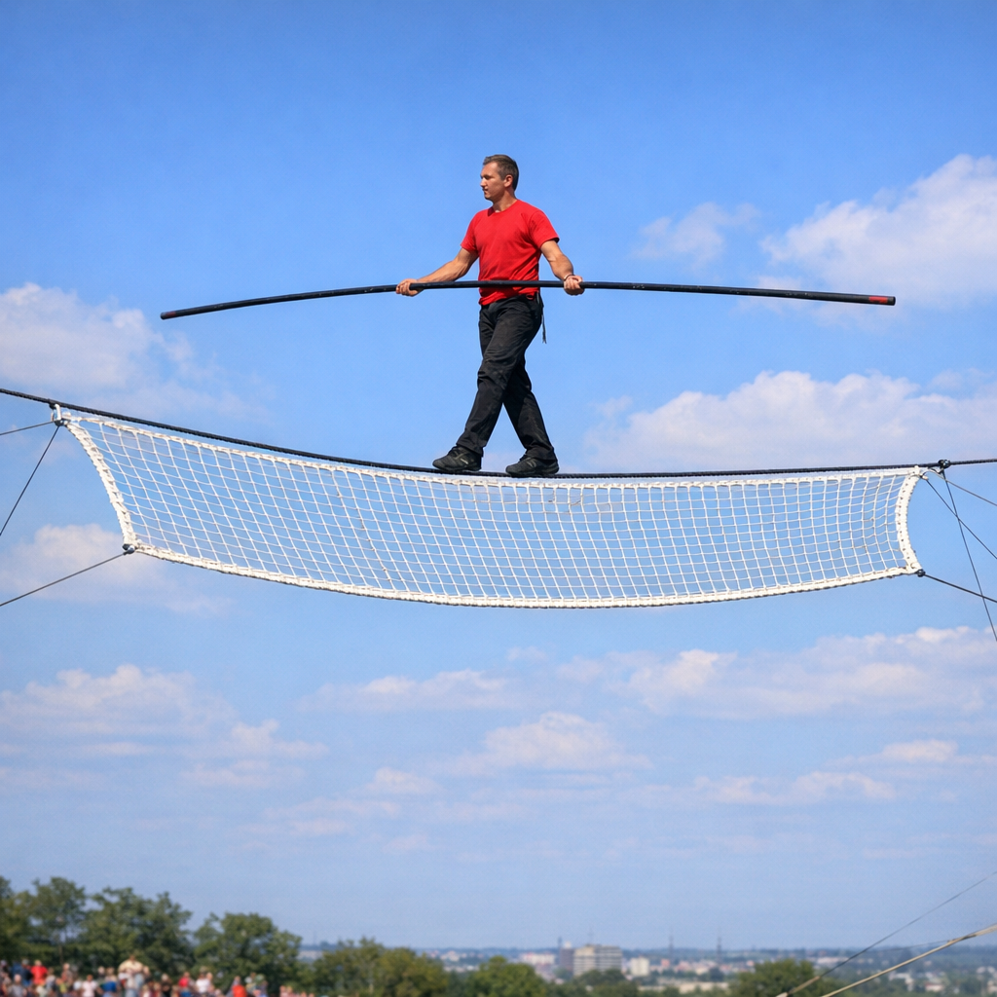
The Margin for Error Is Smaller
The business environment hasn’t gotten simpler. It Is become less forgiving.
Systems are more interconnected
Downtime is noticed faster
Mistakes travel further
Recovery windows are shorter
Good prevention reduces risk.
Resilience determines whether disruption stays manageable or becomes damaging.
Notes:
The key message here is that the world we operate in has changed. It is faster, more connected, and less forgiving when something goes wrong.
Talk about how systems today are deeply interconnected. A problem in one area can cascade quickly into others. Downtime that used to go unnoticed for hours is now flagged in minutes by customers, partners, or employees.
Mistakes travel further because of how integrated everything is. A single misconfiguration or breach can ripple across systems, vendors, and clients faster than ever before.
Recovery windows are shorter because expectations are higher. Clients and stakeholders expect near-immediate resolution. The tolerance for extended outages has shrunk dramatically.
Reinforce the closing point: good prevention reduces how often things go wrong, but resilience is what determines the outcome when they do. Prevention and resilience work together, but resilience is the part most organizations underinvest in.

Slide 16
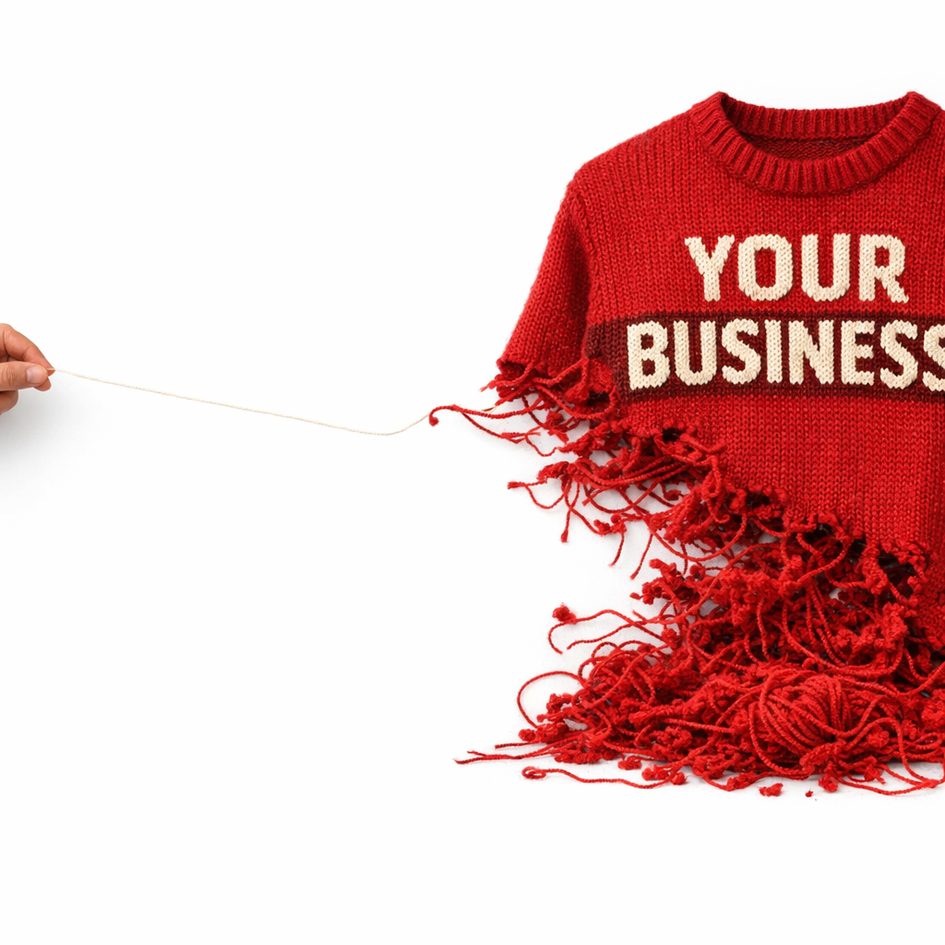
How Small Problems Become Big Ones
Most serious incidents don’t start out serious.
They grow because:
Early signals are missed or ignored
Decision ownership isn’t clear
Teams hesitate instead of acting
The first hour is spent debating, not executing
The difference between a contained incident and a damaging one is rarely the technology. It’s speed, clarity, and coordination.
Good prevention reduces how often problems occur. Resilience determines how far they spread.
Notes:
This is one of the most important points in the whole presentation. Most serious incidents do not start out looking serious. They start small and grow because of how we respond, or fail to respond.
Walk through the four reasons problems escalate. Early signals get missed because no one is watching for them, or they look too routine to flag. Decision ownership is unclear, so multiple people hesitate or step on each other. Teams freeze because there is no playbook for what to do first. And the first hour gets burned in debate instead of action.
Emphasize the closing point: the difference between a contained incident and a damaging one is almost never about the technology. It comes down to speed, clarity, and coordination in those first critical moments.
This ties directly back to the four pillars. Prevention reduces how often things go wrong. Resilience determines how far they spread when they do.

Slide 17
Calm, Capable, and Prepared
Let’s also be clear about something else.
Well‑run organizations don’t panic. They execute!
We invest in prevention to reduce noise and risk
We design operations so failures are contained
We document, rehearse, and refine how we respond
Having security tools doesn’t make you secure.
Having disciplined operations is what makes disruption manageable.
Notes:
Speaker notes (what we actually do):
Prevention first, on purpose. We standardize identity protection, email security, patching, and backup so common failures never become incidents. This removes background noise and lowers day to day risk.
Design for containment. Access is segmented, blast radius is limited, and privileged actions are controlled. When a mistake happens, it stays small by design.
Detect early. We monitor signals that matter and tune alerts so issues are seen quickly and acted on, not buried in noise.
Clear ownership. During an incident, one role is in charge of decisions, one role communicates, and one role executes. No committees in the moment.
Practiced recovery. Backups and recovery paths are tested the way they would be used in real life, under time pressure, not just verified on paper.
Calm communication. Leaders and clients get clear, factual updates. No speculation, no scrambling.

Slide 18

What Sure Systems Does Differently
We focus on:
Recovery, not fear
Predictability, not perfection
Practical steps, not theory
Our goal is simple:
Make your worst day manageable.
This Photo by Unknown Author is licensed under CC BY-NC
Notes:
This is where we connect the presentation back to what we do at Sure Systems. We focus on recovery, not fear. Predictability, not perfection. Practical steps, not theory.
Our goal is simple: make your worst day manageable. Everything we have talked about today is how we think about the work we do with our clients.

Slide 19
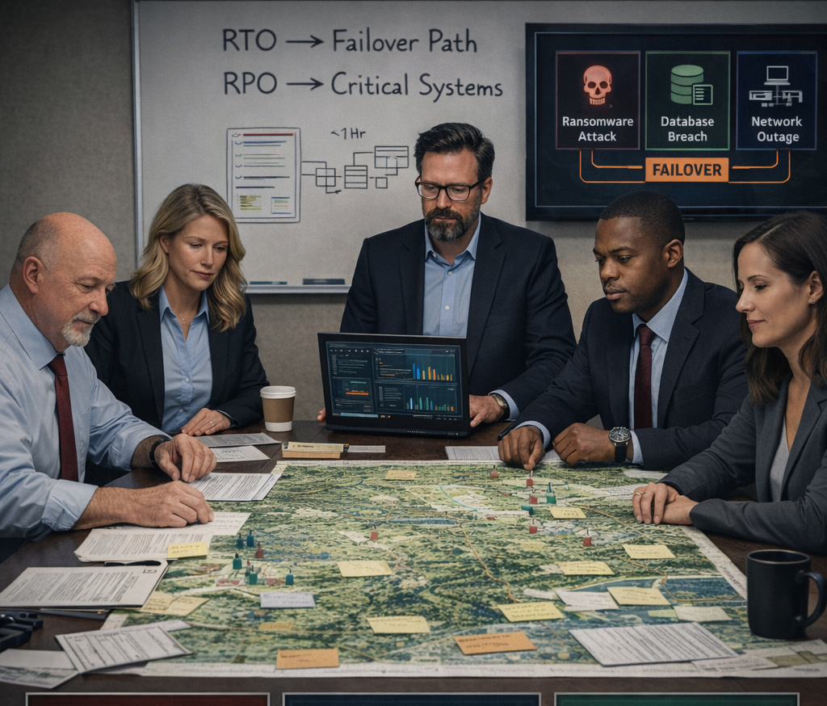
Practice, Not Panic
(For Existing Clients)​
For Managed Clients, we facilitate regular Business Resilience tabletop exercises — a calm, discussion‑based walk‑through of a realistic incident.​
​It helps clarify: Who’s in charge when something breaks​
Whether escalation happens early or late​
How the first hour of decisions would play out​
This is exclusive to existing clients because it builds on the environment and controls we already manage. It’s about improvement — not evaluation.​
GOAL: Make the first hours calm, coordinated, and predictable so recovery is fast and less painful.
Notes:
For existing managed clients, we run regular tabletop exercises. These are calm, discussion-based walkthroughs of realistic incident scenarios.
They help clarify who is in charge, whether escalation happens early or late, and how decisions play out in the first hour. This is about improvement, not evaluation. The goal is to make those critical first hours calm, coordinated, and predictable.

Slide 20

NEXT STEPS
Is Your Business Resilient?
If you were down tomorrow Would recovery be calm and predictable or improvised and chaotic?
For organizations that want clarity:
Start with our Microsoft 365 Reality Check.
A short, practical assessment that replaces assumptions with evidence across security, access, and operational readiness.
No sales pressure. No long projects. Just a clear picture of what is solid, what is fragile, and where attention is needed.
Scan QR Code for M365 Reality Check
Notes:
Close with the question: if you were down tomorrow, would recovery be calm and predictable, or improvised and chaotic?
For anyone who wants clarity, point them to the Microsoft 365 Reality Check. It is a short, practical assessment that replaces assumptions with evidence. No sales pressure, no long projects. Just a clear picture of what is solid, what is fragile, and where to focus.

Slide 21


Slide 22



